Slide 1
T A K E A S T E P T O W A R D S Y O U R H E A L T H

Slide 2
HEALTH INDEX TECHNICAL SPECIFICATION

Slide 3
AGENDA
GENERAL INFORMATION
HOW IS THE HEALTH INDEX CALCULATED
HOW IS BMI INDEX CALCULATED
HOW IS DAILY LIQUIL INTAKE CALCULATED
IDENTIFICATION OF KEY PROBLEMATIC AREAS
RECOMMENDED WALMARK PRODUCTS
GENERATING PERSONALIZED MONHTLY PLAN
EVALUATION OF PROGRESS
T A K E A S T E P T O W A R D S Y O U R H E A L T H

Slide 4
GENERAL INFORMATION FUNCTIONS OVERVIEW

Slide 5
HEALTH INDEX
WHAT IS IT
ü | INTERACTIVE ONLINE PLATFORM
• | Targeting the public to take the first step towards healthy lifestyle & take charge of own health
• | Online test developed in collaboration with metabolic nutrition specialist
• | Tailored monthly plan with expert tips which help consumers improve their Health Index
• | Recommended products in line with tailored monthly plan
• | Results shareable via social media - increase of brand visibility
• | Broader platform with content for consumers’ education about healthy lifestyle
WHAT ARE THE GOALS
ü | BUILD BRAND IMAGE
• | Through tailored expert solution and dialogue with public we will present Walmark as a health partner and expert brand
• | Health Index presents Walmark not only as a sales oriented company, but also as a company that cares about health of consumers and society
• | Data generated by Health Index will provide great source of information which can be used for PR
ü | DRIVE SALES
• | Engage users and activate them to online/offline purchase
• | Drive traffic to commercial channels
• | Acquire unique consumer database and utilize it through CRM
• | Better understanding of consumers needs and utilize the knowledge for future brand offer development
T A K E A S T E P T O W A R D S Y O U R H E A L T H

Slide 6
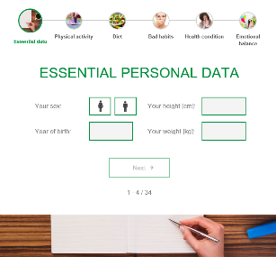
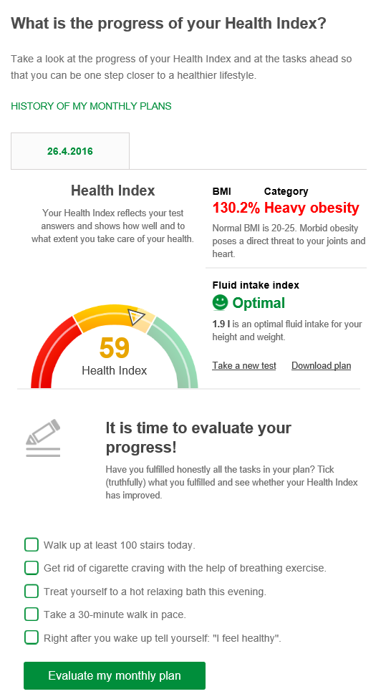
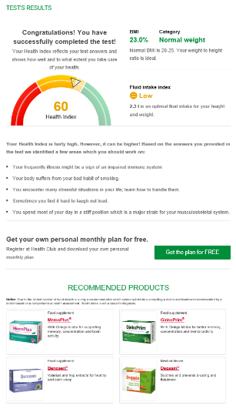
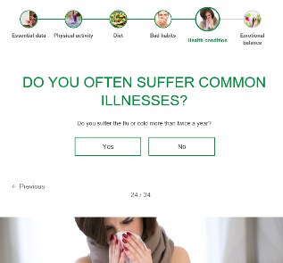
1
ONLINE TEST
2
TAILORED MONTHLY PLAN
3
PERSONAL PROFILE
T A K E A S T E P T O W A R D S Y O U R H E A L T H

Slide 7
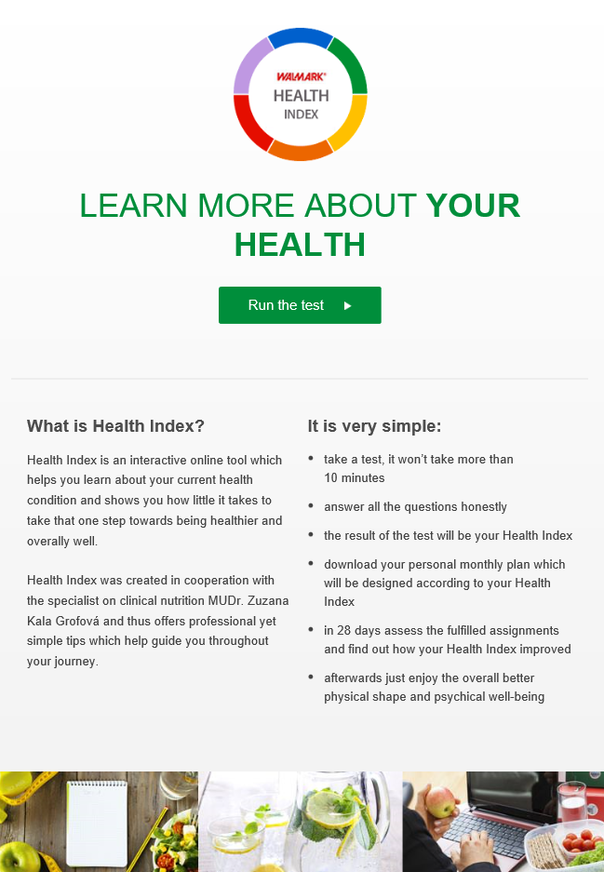
1
ONLINE TEST:
INTRODUCTION
‘RUN THE TEST’ button
INSTRUCTIONS
How to take a test
What you get (outcome)
Encouragement to share on social media
DESCRIPTION
What is health index and what it does
How it was developed
T A K E A S T E P T O W A R D S Y O U R H E A L T H

Slide 8
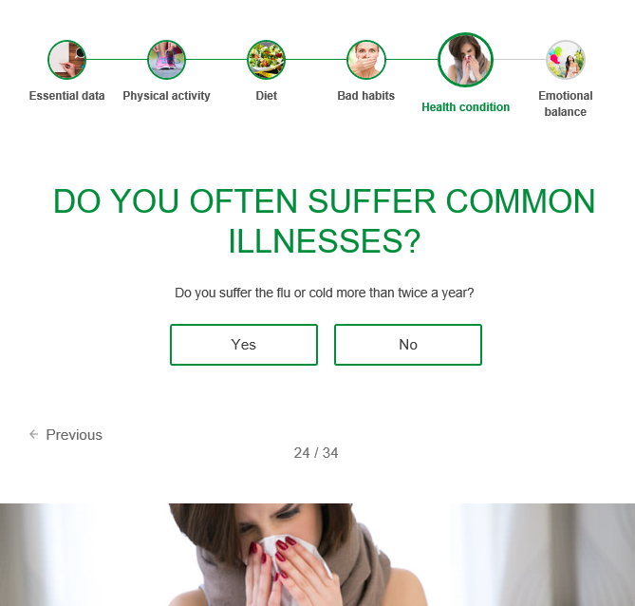
1
ONLINE TEST:
QUESTIONNAIRE
NAVIGATION THROUGH SECTIONS
QUESTION
FURTHER EXPLANATION
ANSWERS TO BE CHOOSEN
POSSIBILITY TO COME TO PREVIOUS QUESTION
STAGE
NUMBER OF ANSWERED QUESTIONS
SECTIONS‘ VISUAL
IDENTIFICATION
T A K E A S T E P T O W A R D S Y O U R H E A L T H

Slide 9
1
ONLINE TEST:
QUESTIONNAIRE
List of all questions can be found in the excel file:
Link to the Excel file (WL Marketing Portal)
The questionnaire consists of:
6 SECTIONS accompanied with relevant imageS
34 QUESTIONS (most of the "yes/no" or "pick 1 from 3 options")
I
II
III
IV
V
VI
4 5 12 2 2 9
Number of questions per each section
T A K E A S T E P T O W A R D S Y O U R H E A L T H

Slide 10
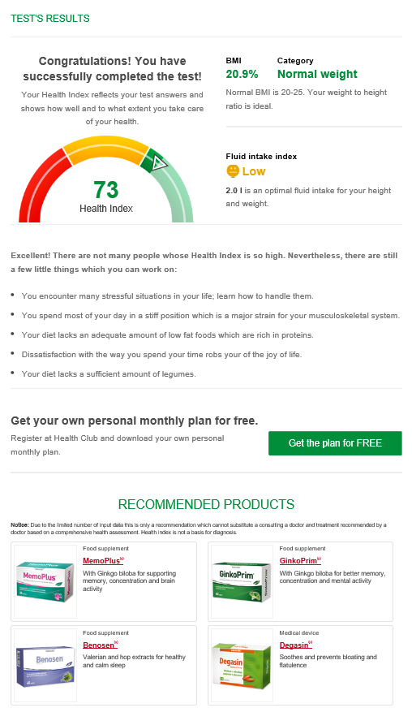
1
ONLINE TEST:
RESULTS
ADDITIONAL HEALTH PARAMETERS
From the obtained information the program calculates also users':
BMI index
• Exact value
• Value category (overweight, normal weight, obesity, heavy obesity)
Liquid intake index
• Value category (insufficient, low, optimal)
• Adequate liquid intake for users' height and weight
HEALTH INDEX
Number in a range 0 - 100 which expresses user‘s health condition
KEY „PROBLEMATIC“ AREAS
Identifies respondent's 5 key areas which should be improved in order to achieve better health index / health condition
ACCESS TO FREE PERSONAL MONTHLY PLAN
Registered respondents (members) can download tailored monthly plan. Unregistered respondents are asked to provide email address to which the plan is sent => CALL TO REGISTRATION
RECOMMENDED PRODUCTS
T A K E A S T E P T O W A R D S Y O U R H E A L T H

Slide 11
2
TAILORED
MONTHLY PLAN
Plan, in form of a one-page PDF document, is received on/can be downloaded from:
• Provided e-mail address
• Personal profile page
User are encouraged to print the plan, put it on visible place (e.g. fridge), tick fulfilled tasks and after one month come back to their profile page to evaluate the progress
Instructions are part of the received e-mail
DAILY TASKS FOR 4 WEEKS
Activities have been designed by a specialist to ensure all health areas are covered and the level of difficulty is adequate to regular consumer – they are doable, achievable, and if strictly followed, an effect should be visible
EXTRA TIPS
Everyday tips for improvement of current ‘problematic’ health areas for each users
T A K E A S T E P T O W A R D S Y O U R H E A L T H

Slide 12
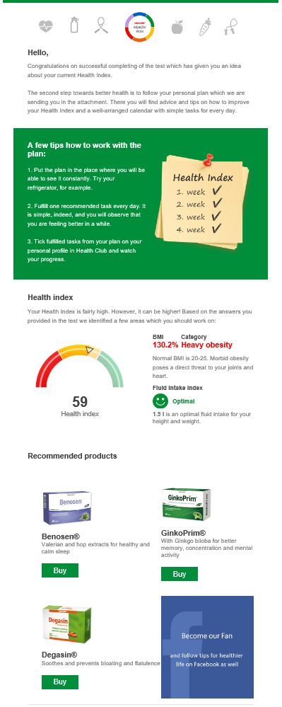
2
MONTHLY PLAN
E-MAIL
INTRODUCTION
E-mail follows the information from results page, but contains also instructions for how to use the tailored monthly plan.
INSTRUCTIONS
RESULTS
RECOMMENDED PRODUCTS
This part of e-mail can be used for communication of any actual product or promo offer
LINK TO FACEBOOK or other social media, websites etc.
T A K E A S T E P T O W A R D S Y O U R H E A L T H

Slide 13
3
PERSONAL
PROFILE
RESULTS
TAKE A NEW TEST and DOWNLOAD CURRENT MONTHLY PLAN
New test cannot be taken earlier than 28 days after the last one
STAGE
Less than 28 days after taking the test: COUNTING DOWN THE DAYS
More that 28 days after taking the test: CALL FOR EVALUATION THE PROGRESS
KEY TASKS FROM PLAN TO BE TICKED
Not possible ealier than 28 after taking the test
T A K E A S T E P T O W A R D S Y O U R H E A L T H

Slide 14
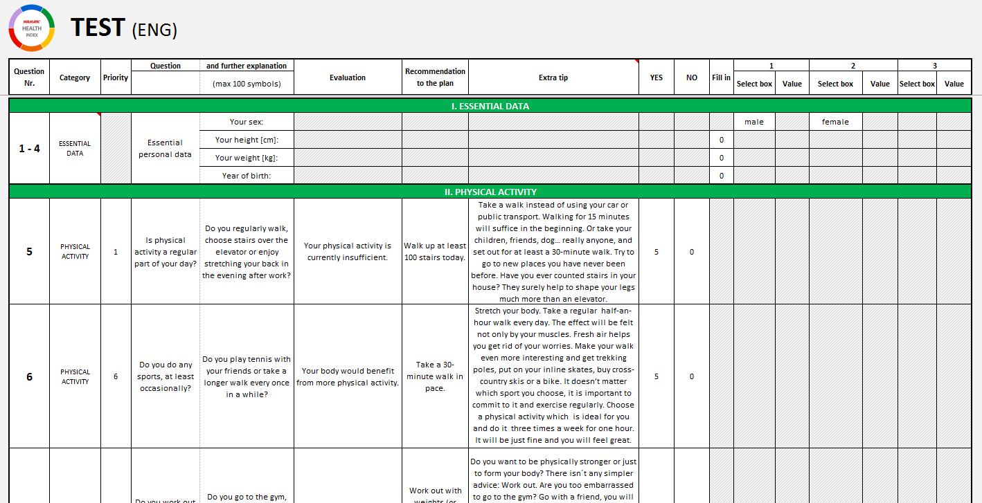
KEY DOCUMENT
Contains all texts, questions, answers and their values, tasks, evaluations, recommended products etc.
Link to the Excel file (WL Marketing Portal)

Slide 15
HOW IS THE HEALTH INDEX CALCULATED

Slide 16
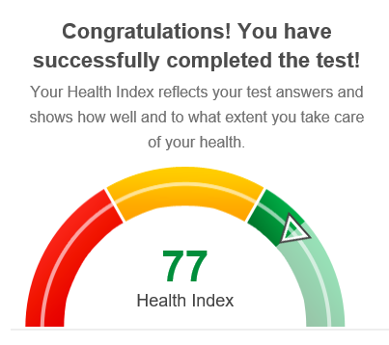
HEALTH INDEX NUMBER
Each question from sections:
Physical Activity (section II)
Diet (section III)
Bad Habits ( section IV)
Immunity (section V)
Emotional balance (section VI)
has predefined answers with assigned value (from 0 to 10) according to its importance and positive impact on Health.
(0 = no positive impact on health, 10 = the highest impact for good health condition)
Respondent during the test collets points from their answers.
HEALTH INDEX IS A SUM OF ALL THE COLLECTED POINTS (max. 100)
Assigned values for each answer are in the HI excel file (see next slide →)
T A K E A S T E P T O W A R D S Y O U R H E A L T H

Slide 17
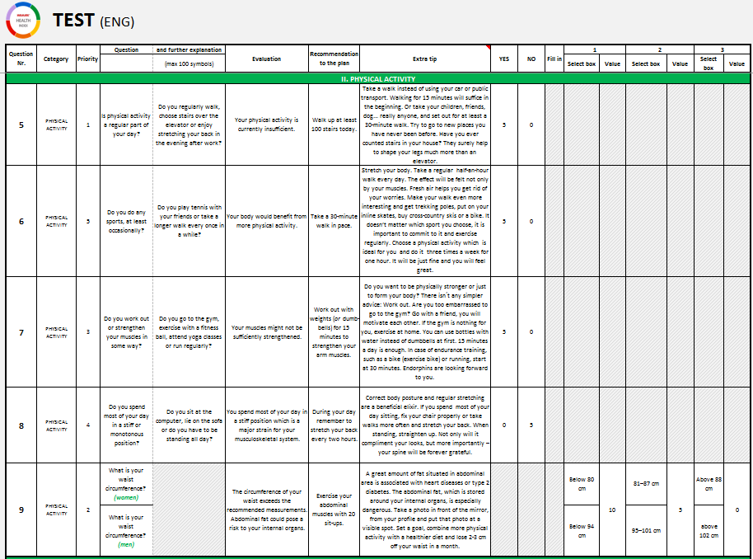
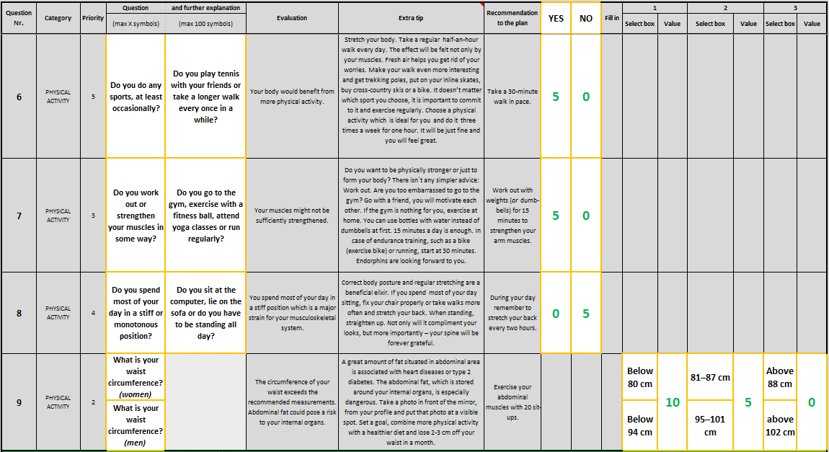
QUESTIONS
YES or NO ANSWERS
Link to the Excel file (WL Marketing Portal)
POINTS ACHIEVED FROM EACH ANSWER
OTHER THAN YES/NO ANSWERS
T A K E A S T E P T O W A R D S Y O U R H E A L T H

Slide 18
HOW IS BMI INDEX CALCULATED

Slide 19
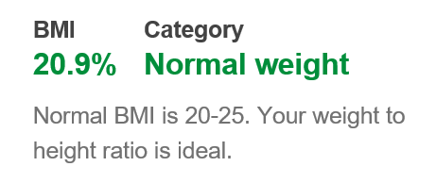
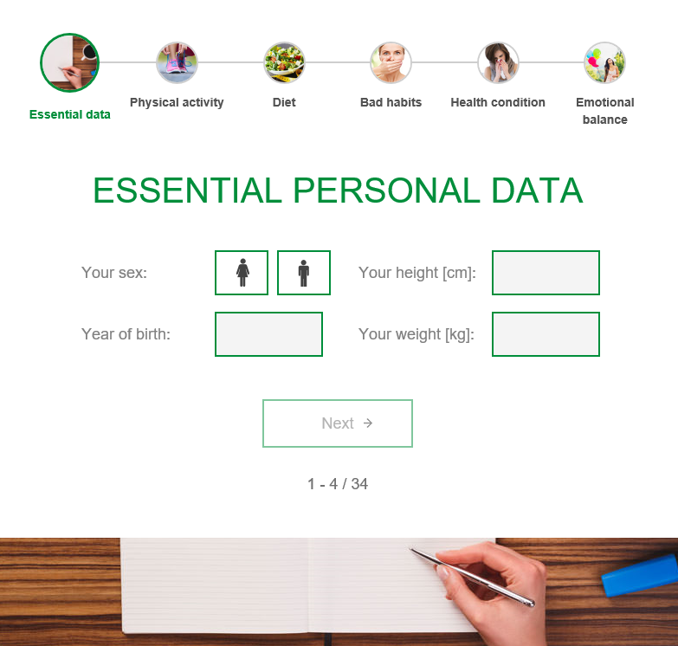
BMI INDEX FORMULA
FORMULA
CATEGORIES
0 – 19,9 | Underweight
20 – 24,9 | Normal weight
25 – 29,9 | Overweight
30 – 34,9 | Obesity
35+ | Heavy obesity
Weight (kg)
Height² (m)
Users fill their height in cm → recalculation to m
TEST - SECTION 1
Each category has a different description text
T A K E A S T E P T O W A R D S Y O U R H E A L T H

Slide 20
HOW IS DAILY LIQUIL INTAKE CALCULATED

Slide 21
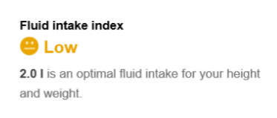
DAILY LIQUID INTAKE: OPTIMAL FLUID INTAKE (F.I.)
FORMULA
Weight (kg) x 0,035
TEST - SECTION 1
T A K E A S T E P T O W A R D S Y O U R H E A L T H

Slide 22
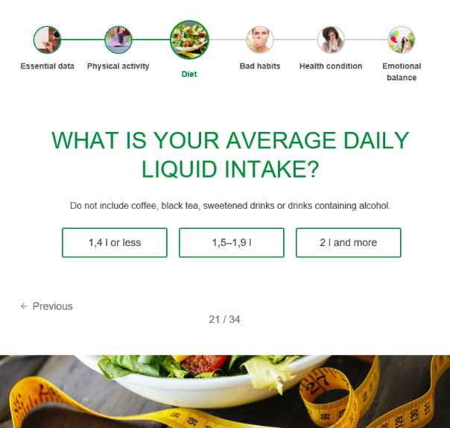
DAILY LIQUID INTAKE: CATEGORY
OPTIMAL F.I.
VS
REALITY
CATEGORIES
Weight (kg) x 0,035
0% – 49% of optimal F.I. | Insufficient
50% – 89% of optimal F.I. | Low
90% + of optimal F.I. | Optimal
always Optimal
T A K E A S T E P T O W A R D S Y O U R H E A L T H

Slide 23
INDENTIFICATION OF KEY PROBLEMATIC AREAS

Slide 24
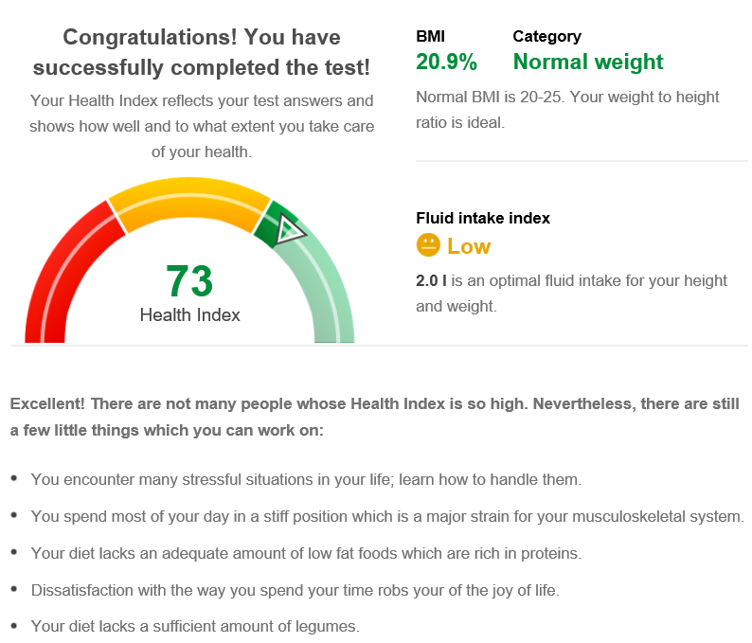
KEY PROBLEMATIC AREAS
Each question has defined:
its own priority
„evaluation“ text in case of choosing 0-value answer
(see next slide ->)
5 key areas are defined and ordered based on questions‘ priority.
For cases when user has less than five 0-value answers from which the key areas can be defined, there are generic standby evaluations prepared.
T A K E A S T E P T O W A R D S Y O U R H E A L T H

Slide 25
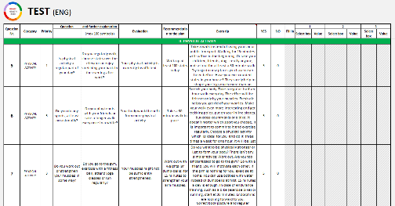
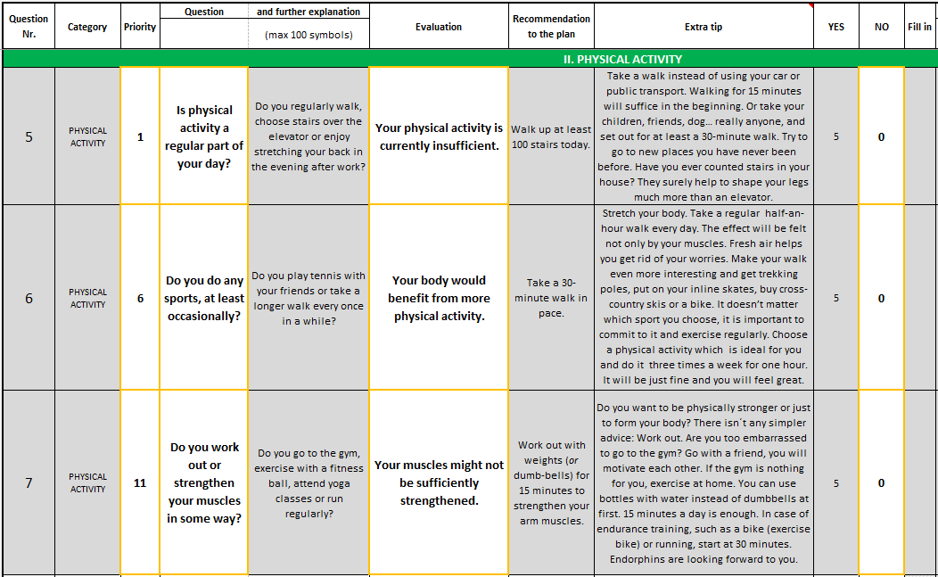
PRIORITY
QUESTION
EVALUATION (TEXT FOR KEY PROBLEMATIC AREAS)
Link to the Excel file (WL Marketing Portal)
CONDITION: 0-value answers
T A K E A S T E P T O W A R D S Y O U R H E A L T H

Slide 26
RECOMMENDED WALMARK PRODUCTS

Slide 27
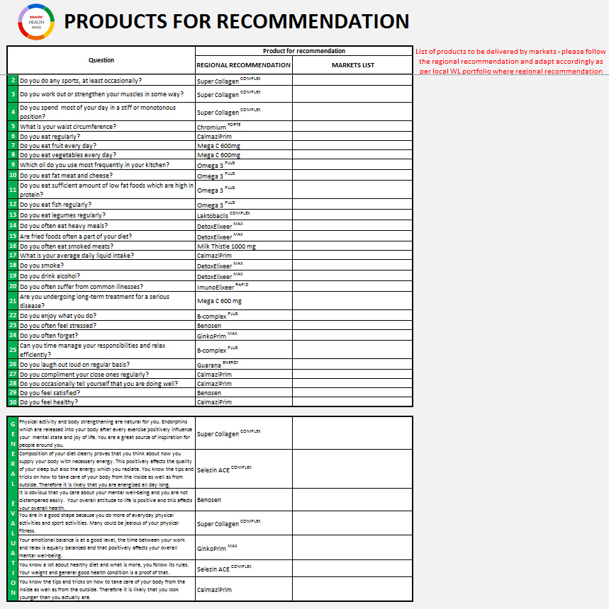
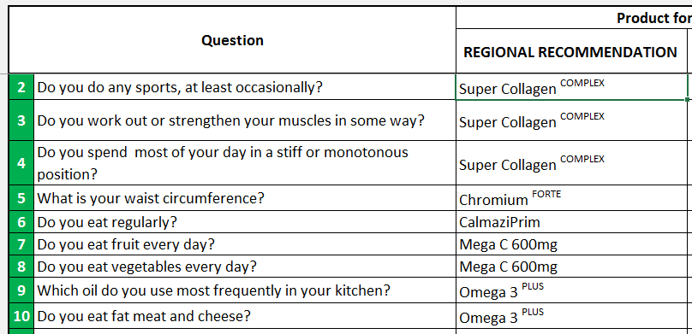
RECOMMENDED WALMARK PRODUCTS
Each question for 0-value answer is linked to a specific product.
Products are generated based on question‘s priority.
Several questions can have the same product to be recommended. Products which would repeat in results are shown only once.
Regional recommendations can be found in excel file:
Link to the Excel file (WL Marketing Portal)
List of products must be adapted accordingly as per local WL portfolio where regional recommendation not applicable
T A K E A S T E P T O W A R D S Y O U R H E A L T H

Slide 28
GENERATING PERSONALISED
MONHTLY PLAN

Slide 29
MONTHLY TASKS
4-weeks/28-days plan with a recommended activity for each day is generated dynamically and specifically for each user = personalized plan
There are 7 different ‘tasks’ per week:
5 generated based on user‘s answers
2 selected from generic tasks
Tasks repeat every week in a different order
Extra tips under the plan complement the daily tasks with additional information and recommendations.
They are automatically generated with the tasks.
4-WEEKS TASKS
EXTRA
TIPS
T A K E A S T E P T O W A R D S Y O U R H E A L T H

Slide 30
Daily task are generated and ordered based on question's priority
(question‘s priority = task‘s priority)
Priorities has fixed position in the 28-days monthly plan:
 | MON | TUE | WED | THU | FRI | SAT | SUN
WEEK 1 | 1 (task with the highest priority) | 2 (task with the 2nd highest priority) | 3 (task with the 3rd highest priority) | 4 (task with the 4th highest priority) | 5 (task with the 5th highest priority) | 6 (task with the 6th highest priority) | 7 (task with the 7th highest (lowest) priority)
WEEK 2 | 3 (task with the 3rd highest priority) | 4 (task with the 4th highest priority) | 1 (task with the highest priority) | 2 (task with the 2nd highest priority) | 7 (task with the 7th highest (lowest) priority) | 5 (task with the 5th highest priority) | 6 (task with the 6th highest priority)
WEEK 3 | 7 (task with the 7th highest (lowest) priority) | 3 (task with the 3rd highest priority) | 5 (task with the 5th highest priority) | 6 (task with the 6th highest priority) | 1 (task with the highest priority) | 2 (task with the 2nd highest priority) | 4 (task with the 4th highest priority)
WEEK 4 | 5 (task with the 5th highest priority) | 6 (task with the 6th highest priority) | 4 (task with the 4th highest priority) | 7 (task with the 7th highest (lowest) priority) | 2 (task with the 2nd highest priority) | 3 (task with the 3rd highest priority) | 1 (task with the highest priority)
T A K E A S T E P T O W A R D S Y O U R H E A L T H

Slide 31
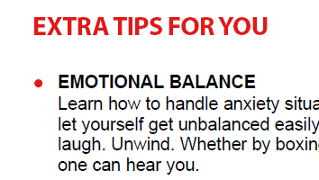
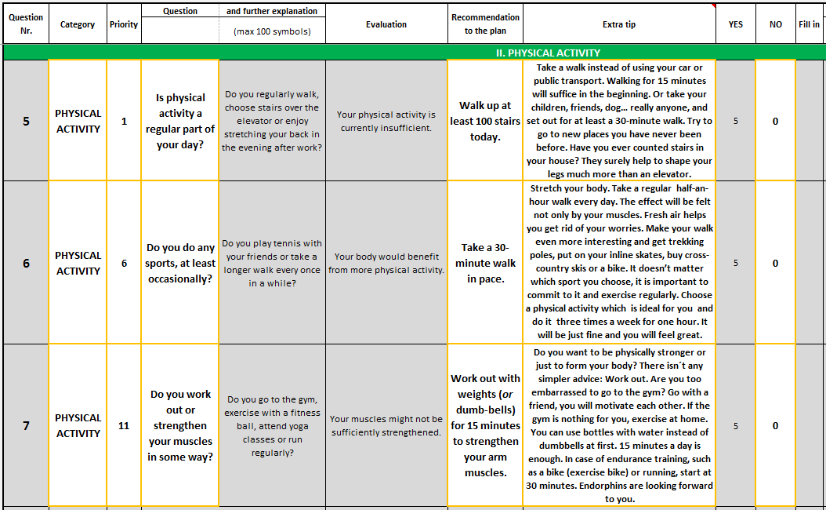
PRIORITY
CATEGORY
QUESTION
TASK FOR PLAN
EXTRA TIP
Link to the Excel file (WL Marketing Portal)
CONDITION: 0-value answers
T A K E A S T E P T O W A R D S Y O U R H E A L T H

Slide 32
EVALUATION OF PROGRESS

Slide 33
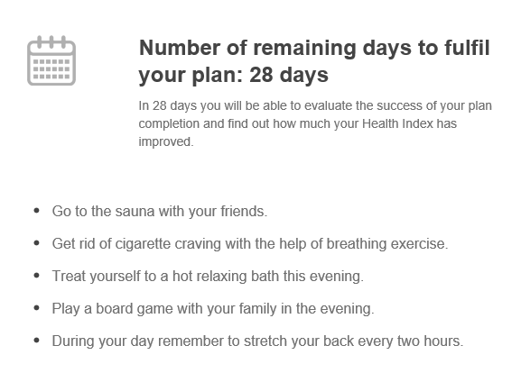
EVALUATION OF PROGRESS
Evaluation is not possible earlier than 28-days after taking the test:
Less than 28 days after taking the test: COUNTING DOWN THE DAYS
More that 28 days after taking the test: CALL FOR EVALUATION THE PROGRESS (user receives informative email)
By ticking all fulfilled tasks and clicking on a button „Evaluate my monthly plan“ Health index number is then recalculated.
Each fulfilled task increases HI by the same value as the „correct“ (non 0-value) answer for the same connected question would .
HI number changes after submitting the evaluation, not while ticking the tasks, so the calculation mechanism is less detectable.
T A K E A S T E P T O W A R D S Y O U R H E A L T H

Slide 34
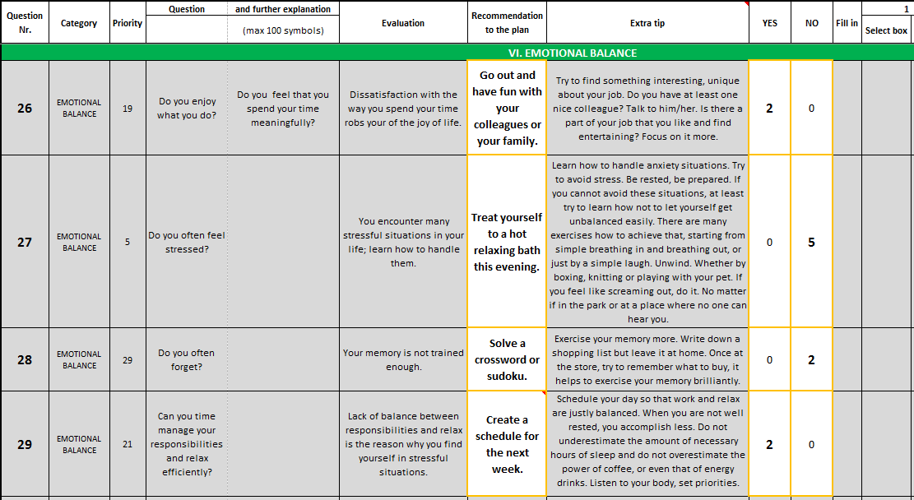
EVALUATION OF PROGRESS
TASK
ANSWERS & VALUES
Link to the Excel file (WL Marketing Portal)
0-value = condition for generating tasks
Fulfilled task increases HI by the same value as the „correct“ answers
T A K E A S T E P T O W A R D S Y O U R H E A L T H

Slide 35
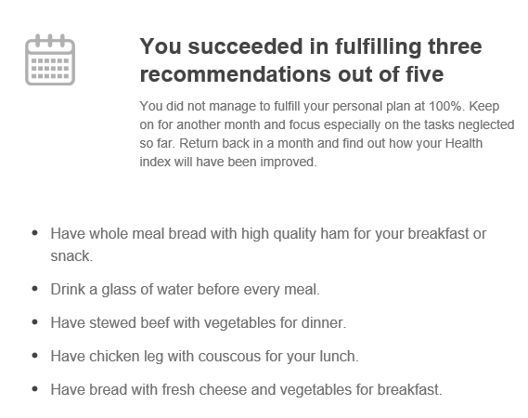
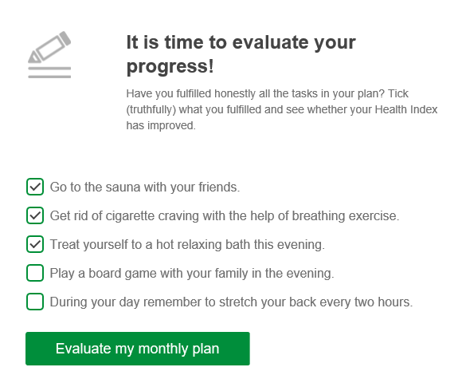
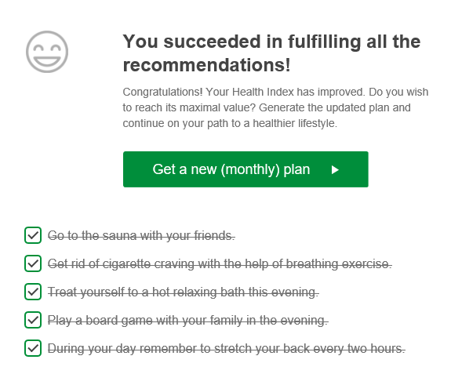
GENERATING NEW PLAN
New plan is generated based on 2 possible situations:
Only some of the tasks were fulfilled: Newly generated plan contains the same tasks as the previous one = RETAKING THE PLAN In case that user again fulfills the same tasks as previously, Health Index then does not change
All tasks were fulfilled: New plan is generated based on the taken test with tasks of lower priority (5th – 10th)
T A K E A S T E P T O W A R D S Y O U R H E A L T H

Slide 36
T A K E A S T E P T O W A R D S Y O U R H E A L T H

